Slide 1



Marketing the Annual Charity Fish Fry
How Blendon 339 Masonic Lodge promotes their fundraising event for Westerville Special Olympics

Slide 2
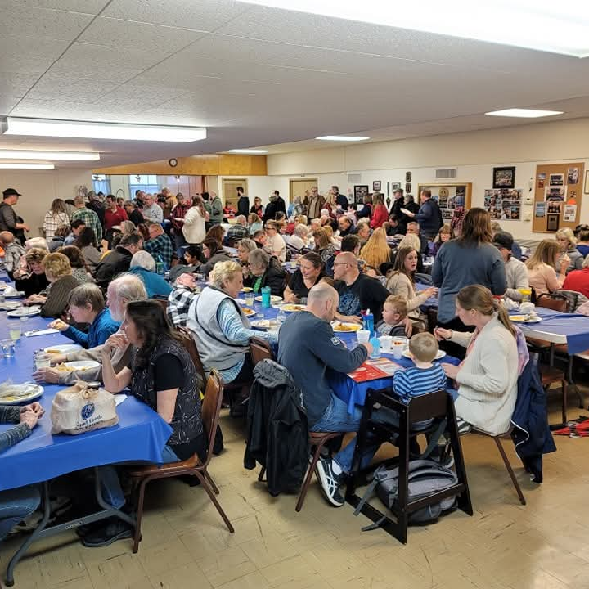
The Event & Its Purpose
Annual Charity Fish Fry
Hosted by Blendon 339 Masonic Lodge in Westerville, Ohio. This community fundraising event supports the Westerville Special Olympics, bringing together local residents for a great cause.
The event serves multiple purposes: raising funds, building community connections, and increasing visibility of the Masonic Lodge in Westerville.

Slide 3
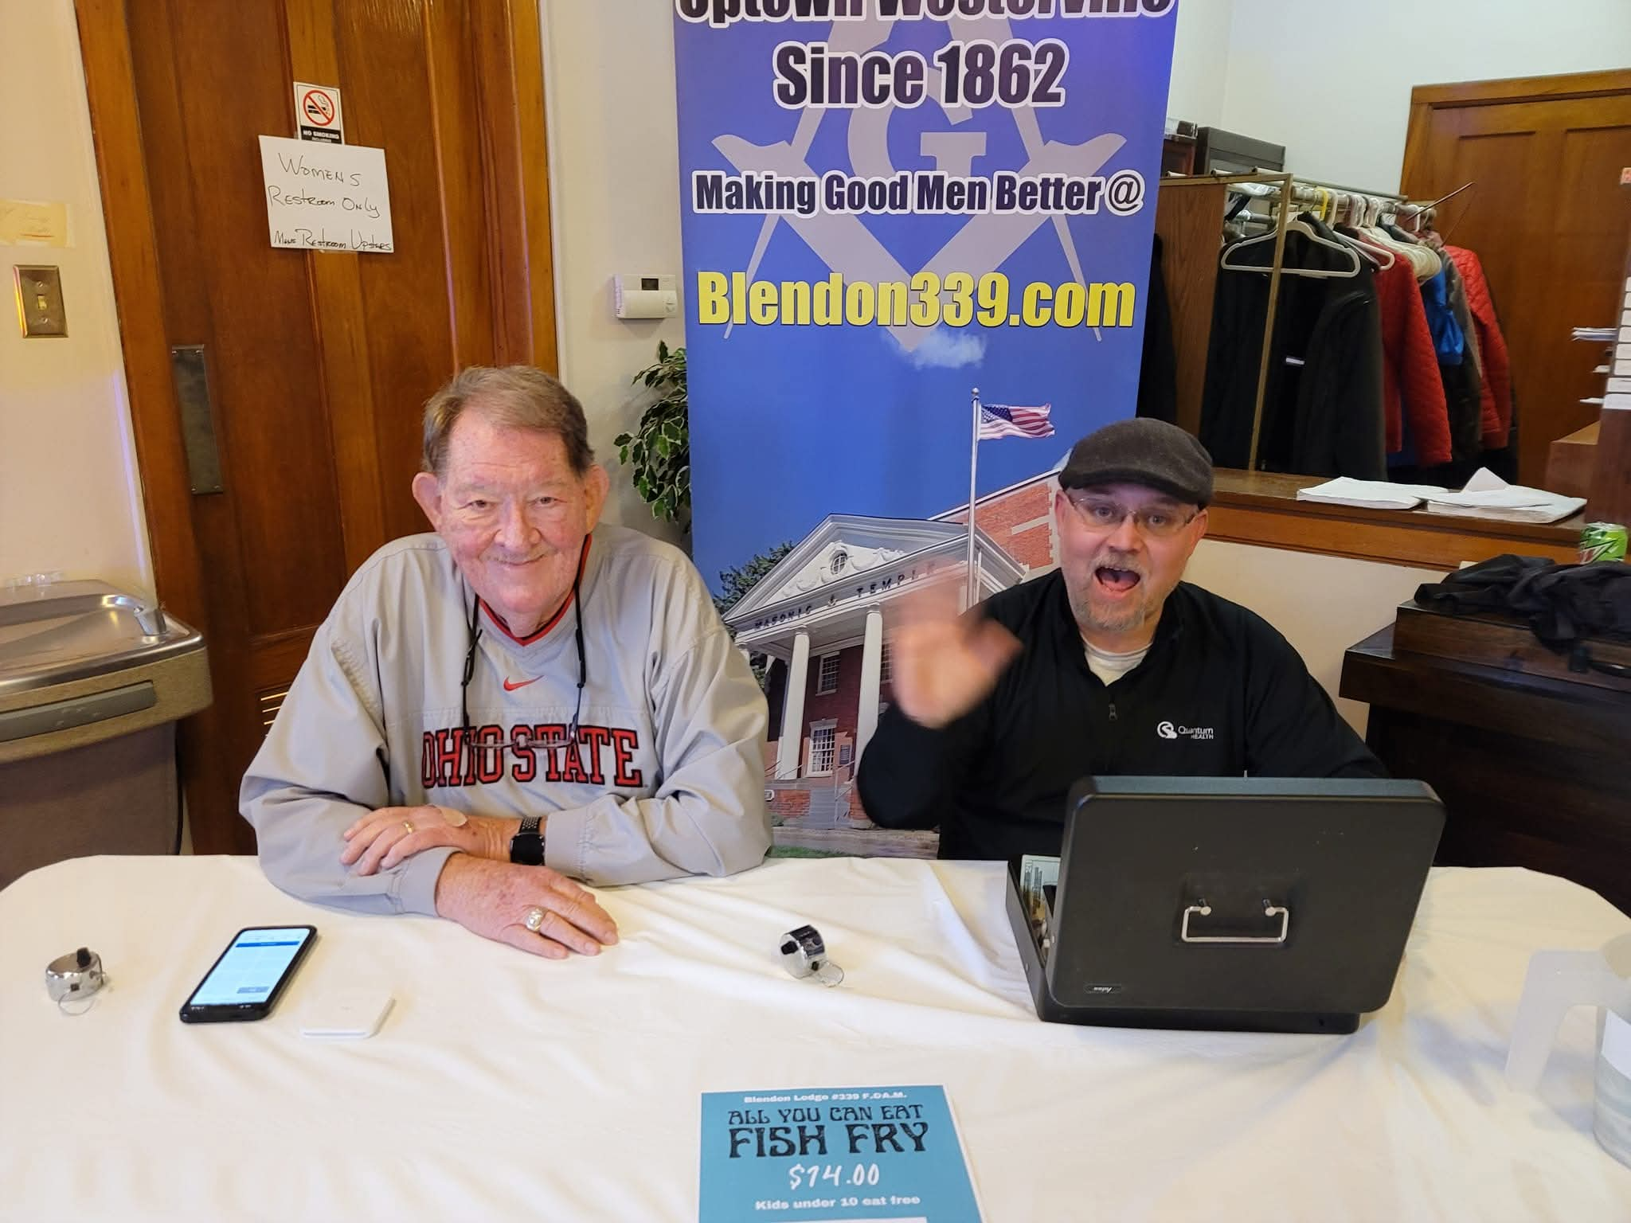
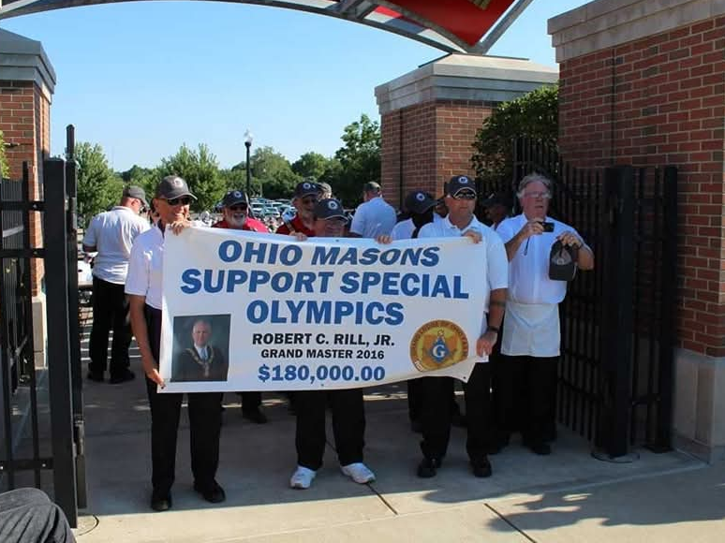
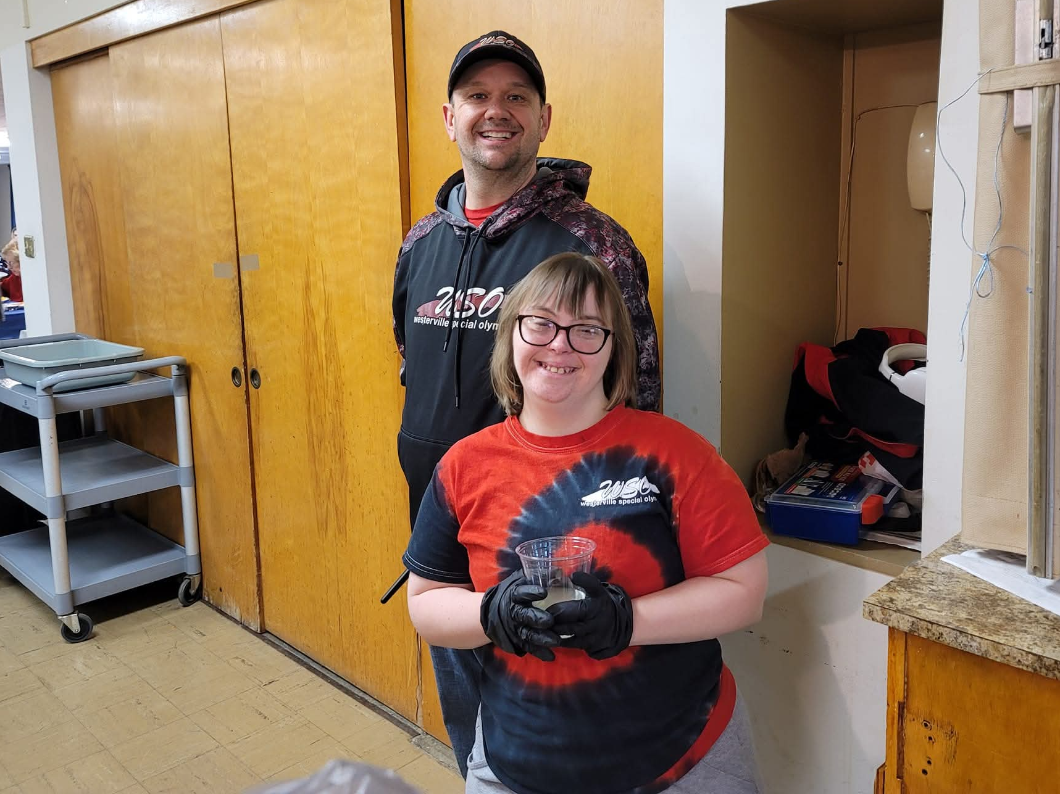
Marketing Goals Made Simple
Sell More Tickets
Build Community Support
Raise Lodge Visibility
The primary goal is increasing attendance and ticket sales for the fish fry event.
Strengthen relationships with local residents and create lasting support for Special Olympics.
Showcase the positive impact of Freemasonry in the Westerville community.

Slide 4
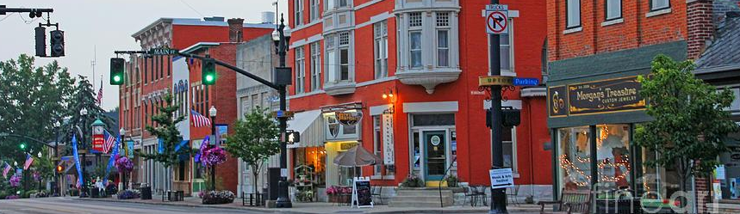



Who We're Trying to Reach
Local Residents
Local Officials
Community Groups
Westerville community members who want to support a good cause while enjoying great food.
Elected officials, first responders, and municipal workers who serve the community.
Local churches, Magazines, Community Calendars, Lodges, and Special Olympics supporters.

Slide 5
The Marketing Timeline
Information Gathering
1
Months before: Update contact lists, gather emails, social media accounts to tag,
and key audience details.
2
Planning Phase
Develop strategy, update visuals, check website and Google Maps listing freshness, create marketing materials and QR codes.
Launch Campaign
3
Weeks prior: Social media posts, email blasts, fax communications, and distribute flyers.
4
Ramp-Up
Final weeks: Intensify promotion with follow-up posts and increased social media activity.

Slide 6

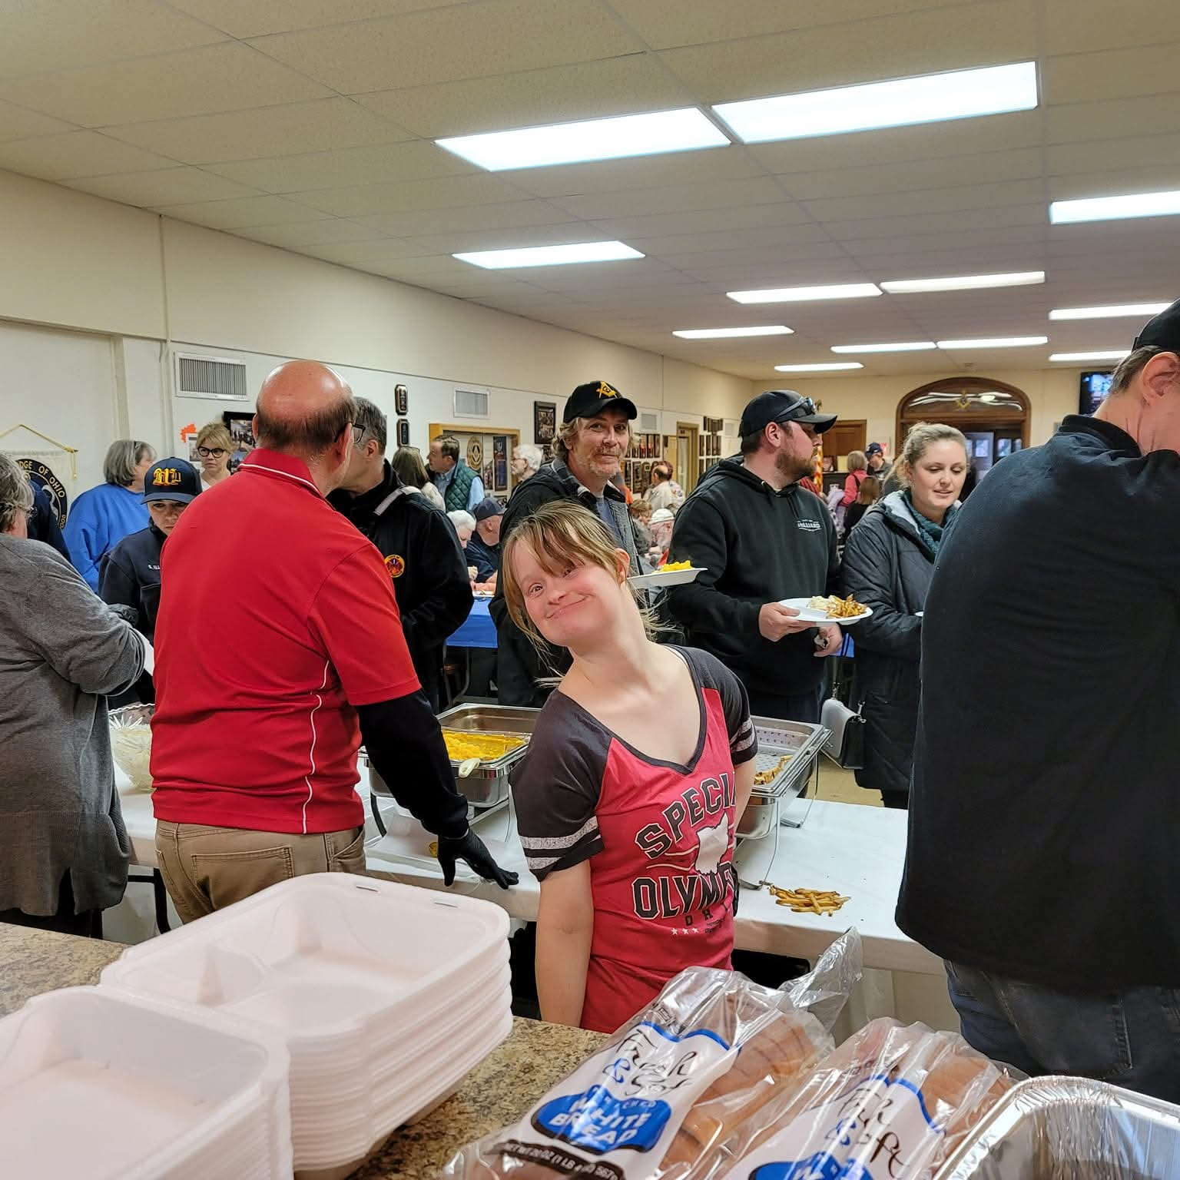
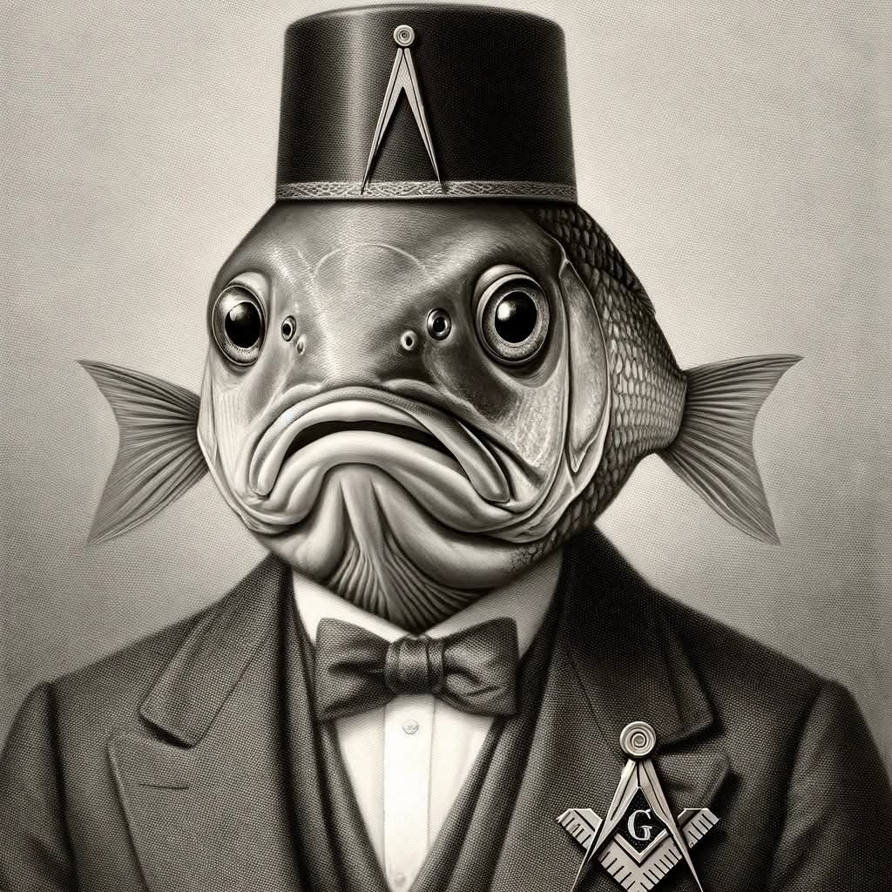
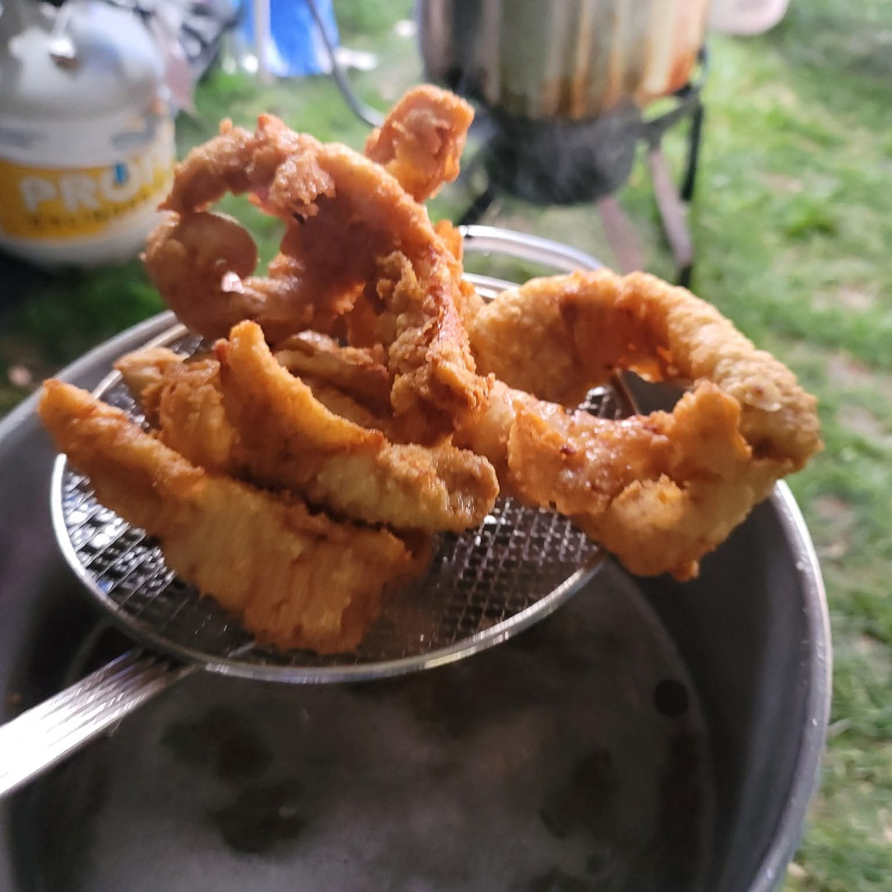
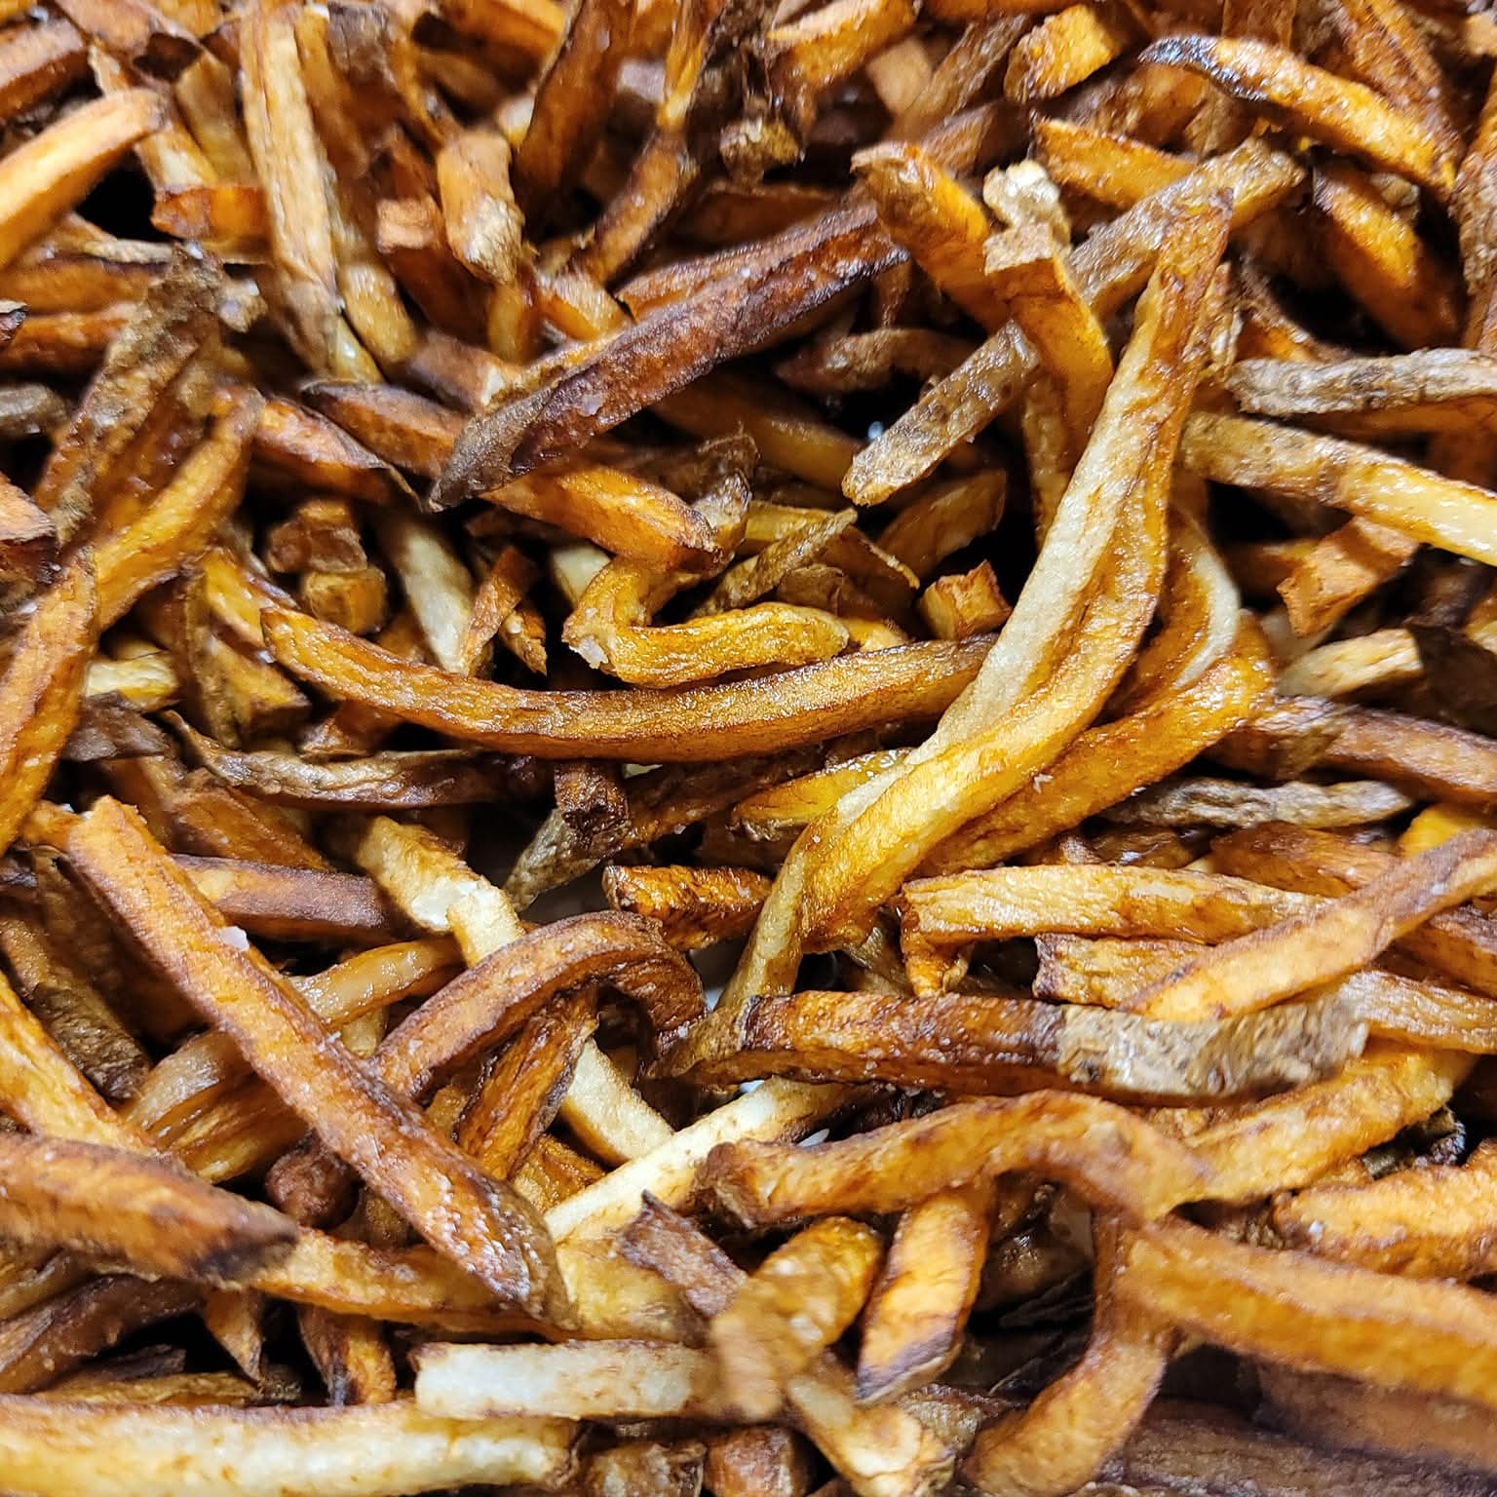
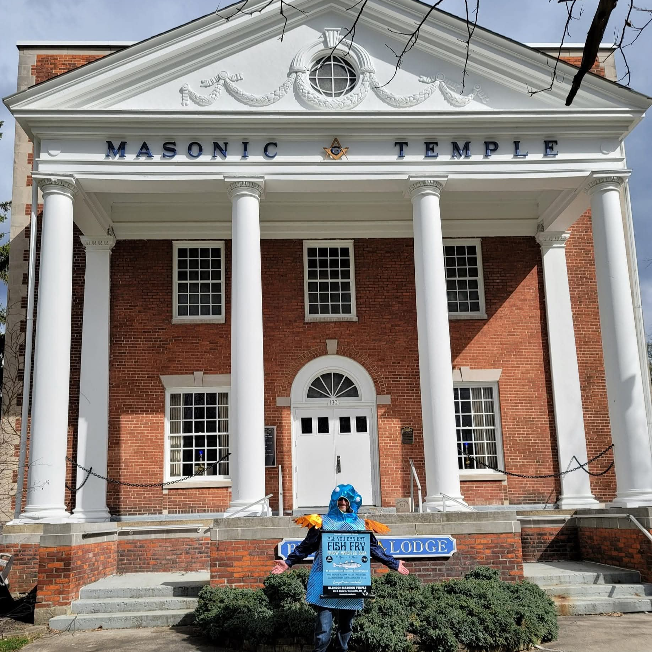
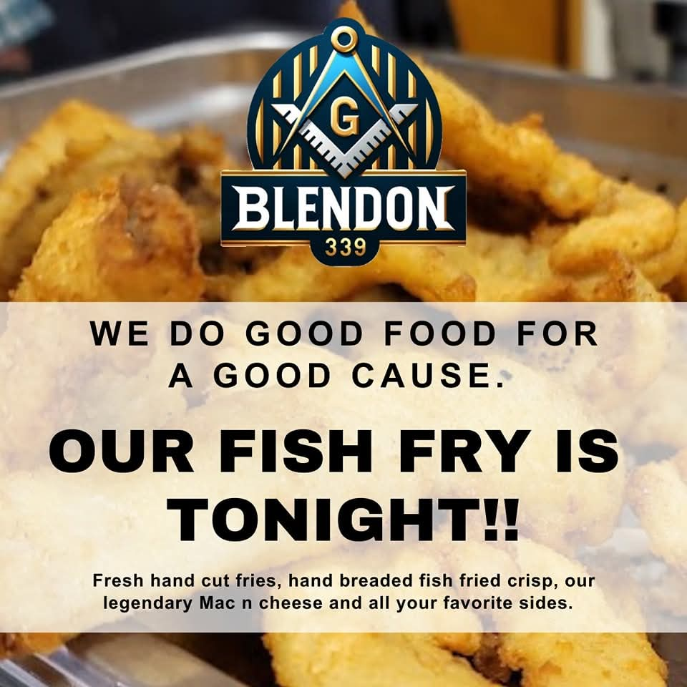
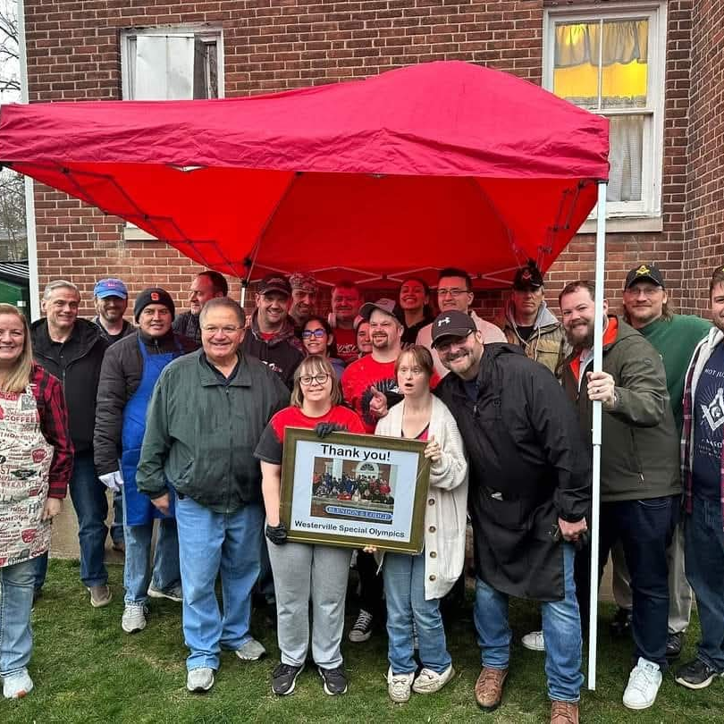

Digital Media Strategy
Facebook Focus
Create dedicated event page
Share in local community groups
Run targeted, local advertising campaign on Facebook
Post follow-up reminders using hashtags and tagging local interest pages with engaging photos or graphics
Reddit Outreach
Engage in r/Columbus discussions about local events and food recommendations.
Community Calendars
Publishing event details to multiple local community calendars gives people more chance to see it - even if they might not normally connect with Freemasonry or Social Media.

Slide 7
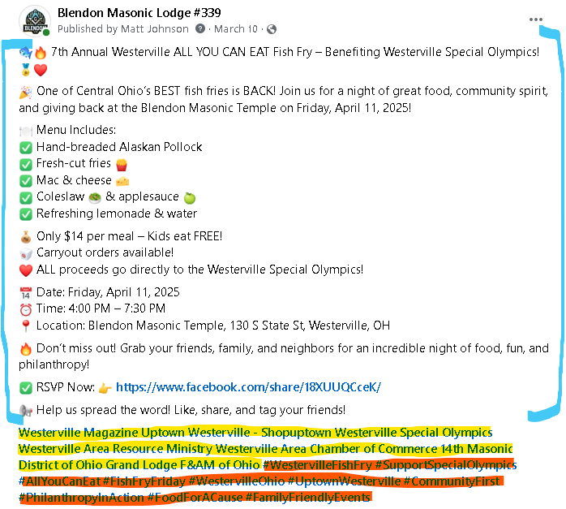

What Goes Into a Post?
Who, What, When, Where, Why!
(blue) Ensure basic details are included in the post so when it gets shared it has everything contained already. Including RSVP/Event link!
(yellow) Tag local interest pages so they get notified about the post to entice them to share
(orange) Relevant hashtags attach the post to larger conversations in the community
Visual aids like the below graphic are used to convey and reinforce the same information in (blue)

Slide 8

Traditional Communication Methods
Email Marketing
Fax Communications
Form Submissions
Direct e-blasts to segmented audience lists including news media, elected officials and more!
Yes, fax still works! Municipal departments and government offices often leverage faxes.
Reach churches and officials through their website contact forms when email isn't available.

Slide 9
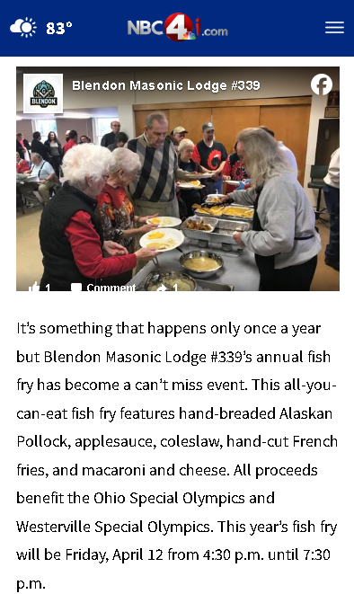
Why We Focus on Local Outreach
We’re not trying to go viral — we’re trying to get people in the door. Local is Where the Results Are!
Local Calendars & Magazines
→ These are read by people already looking for something to do nearby
Westerville-Area Facebook Groups
→ That’s where your neighbors hang out online — not strangers two counties away
Local News Outlets
→ Small blurbs and event listings go a long way when the audience is nearby
Don’t Waste Effort on National or Regional Groups
People from Cleveland, Dayton, or Kentucky aren’t coming to a Westerville fish fry event
National Facebook groups, statewide calendars, or broad Masonic forums?
→ Wrong audience. No return

Slide 10
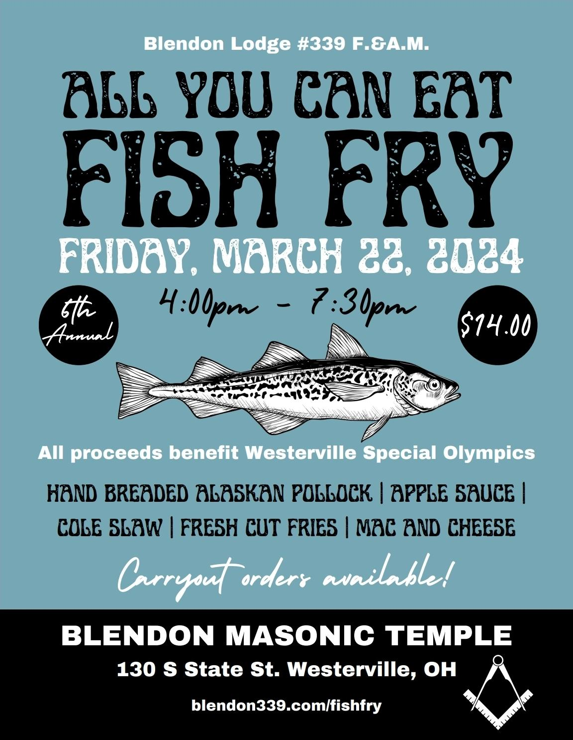
Marketing Materials
Printed Flyers
Small batch printing for high-traffic community locations. Physical materials still matter for local outreach.
Updated Visuals
Refresh banners, signage, business cards, and QR codes to maintain professional appearance.
Website / Social Updates
Keep lodge website, socials and calendar current with event information and deeper information about the Lodge. Showcase who the Lodge is!

Slide 11
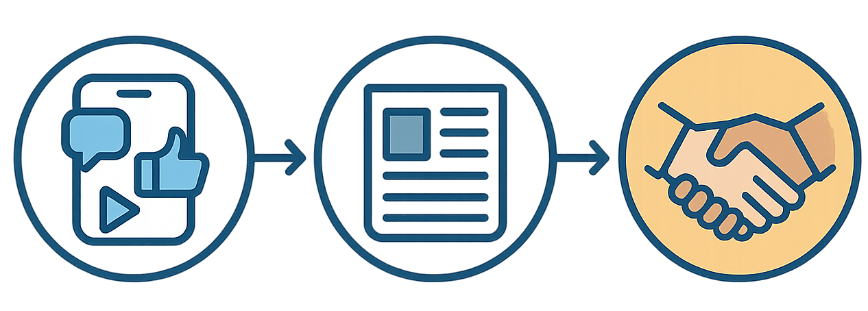



Multi-Channel Approach Works
Digital Channels
Traditional Methods
Community Impact
Social media, email, and website updates reach tech-savvy audiences.
Fax, flyers, and direct contact ensure no one is left out of the invitation.
Combined efforts create maximum awareness and support for Special Olympics.

Slide 12





Success Through Organization
The key to effective event marketing isn't just creativity—it's systematic planning and execution across multiple channels.
Detailed Planning
Know Your Audience
Contact lists, templates, and timelines ensure nothing falls through the cracks.
Different groups prefer different communication methods—use them all.
Community First
When marketing serves a charitable cause, authentic community connection drives success.

Slide 13




Post-Event Follow-Up: What Happens Next?
The event may be over—but the relationship with the community continues.
Thank Your Supporters
Send appreciation emails or hand-written notes
Post a thank-you message on Facebook (tag supporters)
Share the Results
How many meals served?
How much raised for Special Olympics?
Photos or stories from the event? Share those!
Ask for Feedback
Simple survey or casual conversations
Learn what people liked — and what to improve
Start Thinking About Next Year
Note what worked (ads, flyer locations, social media timing)
Save templates and contact lists for easy use next time

Slide 14
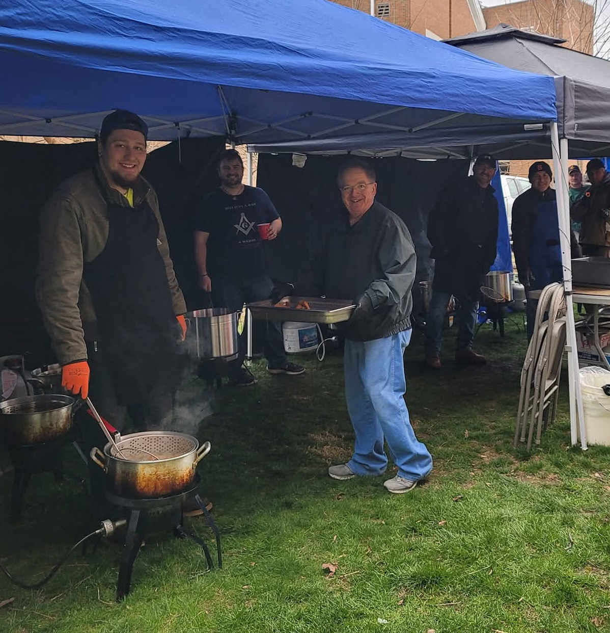
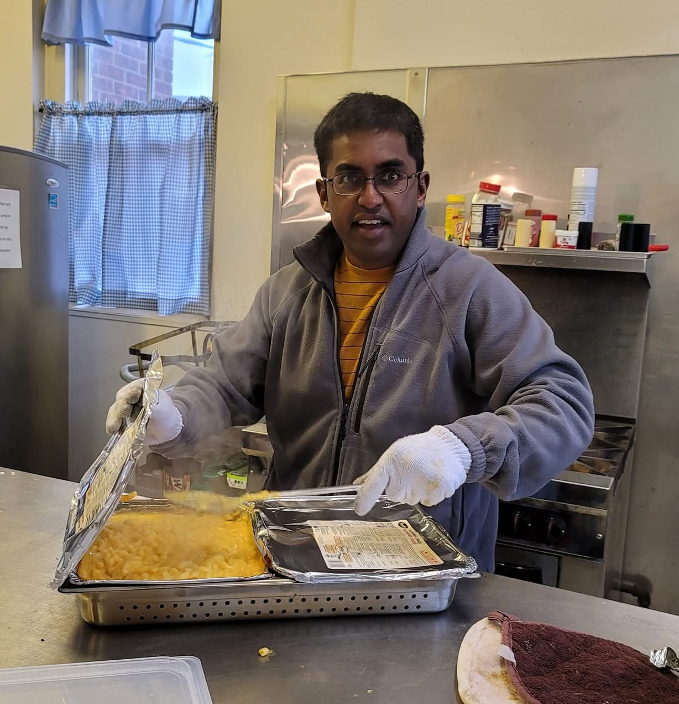
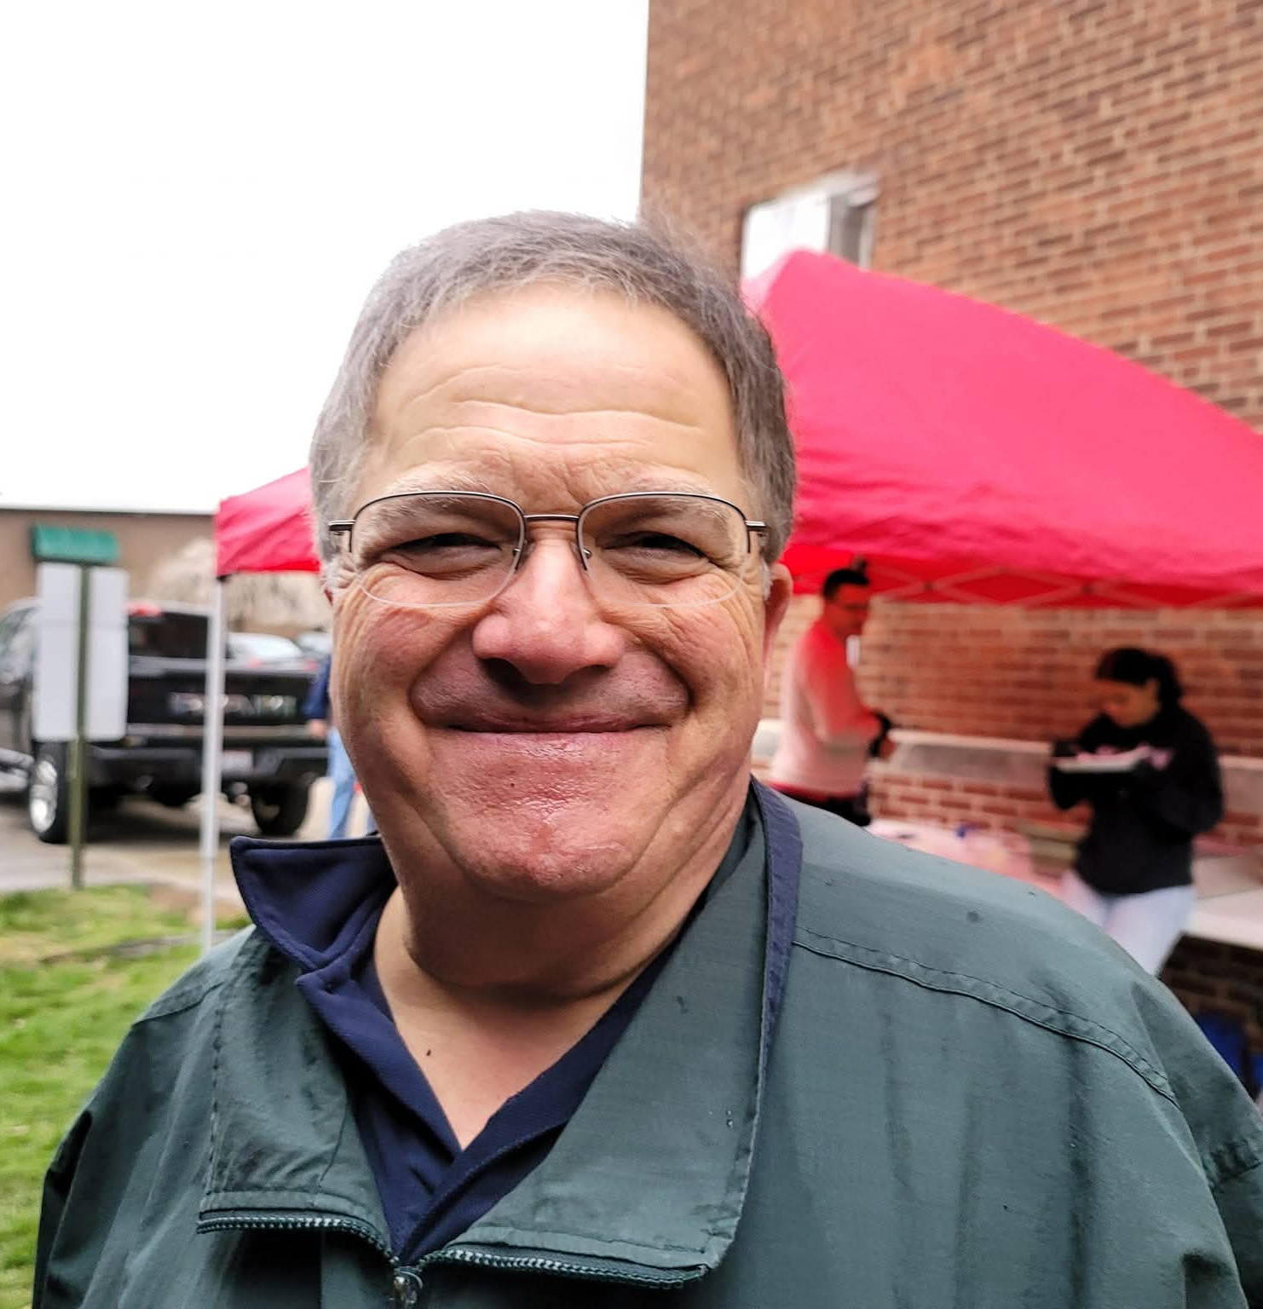

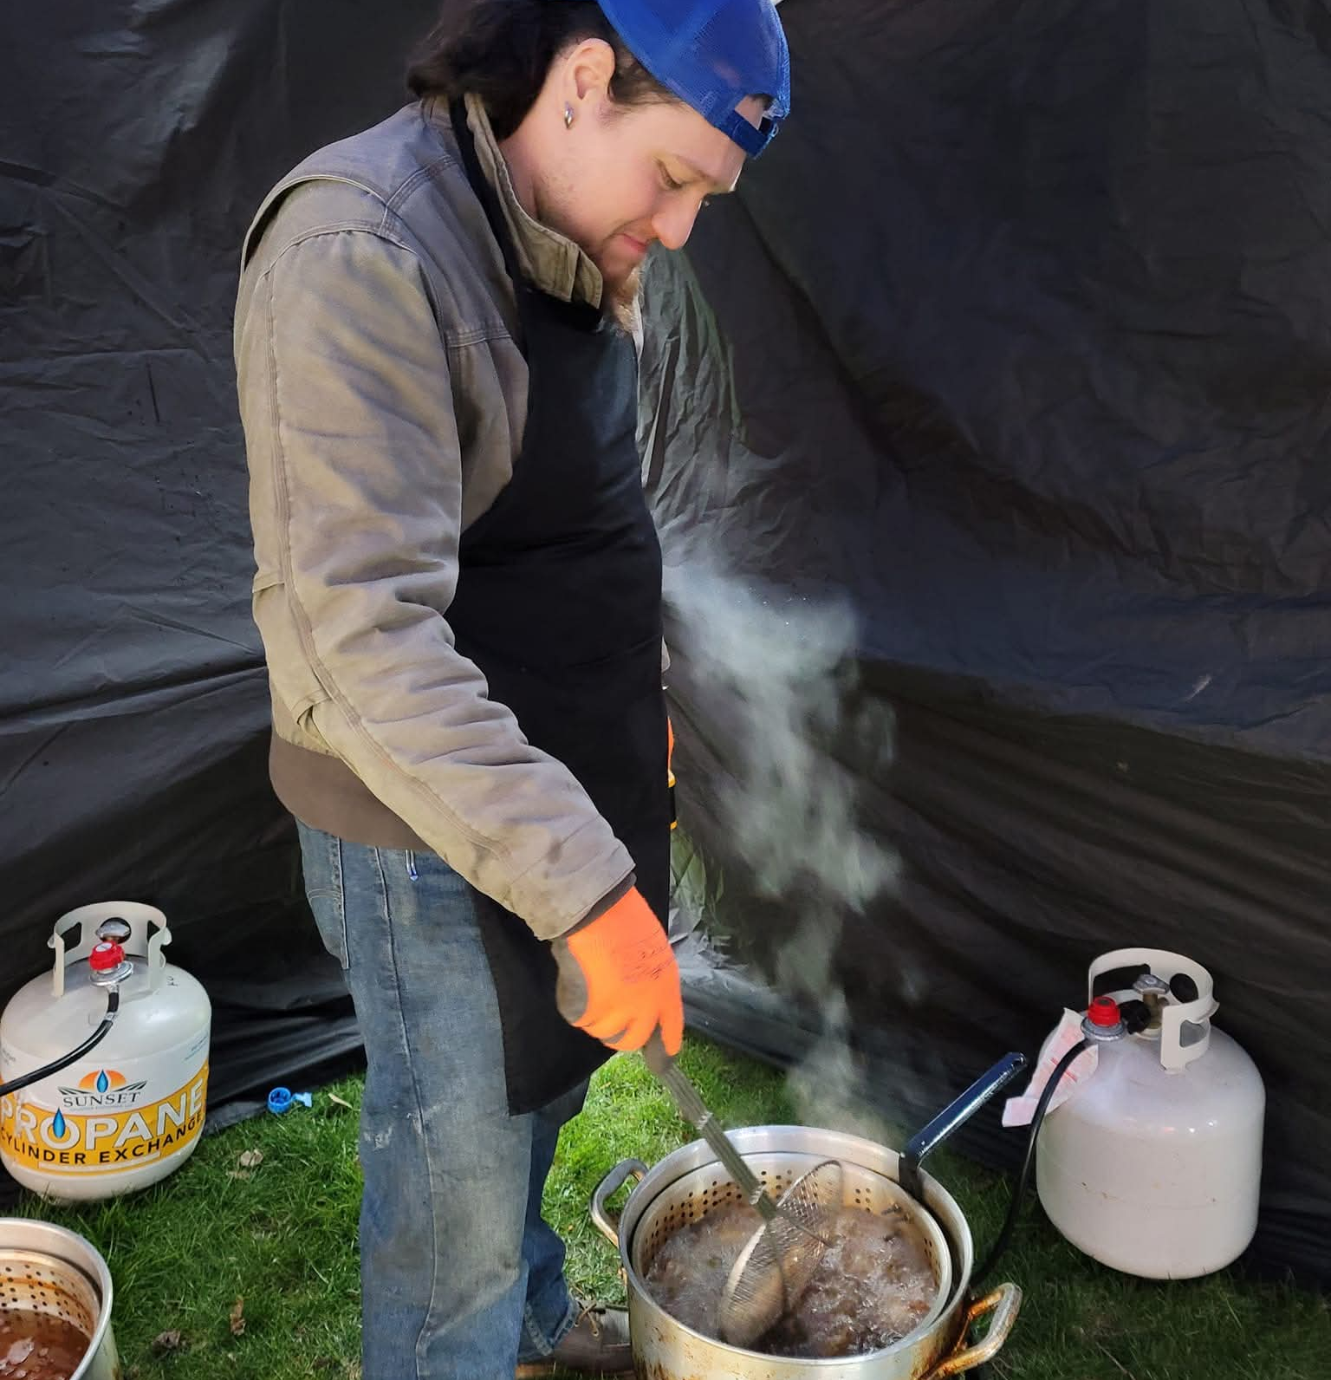
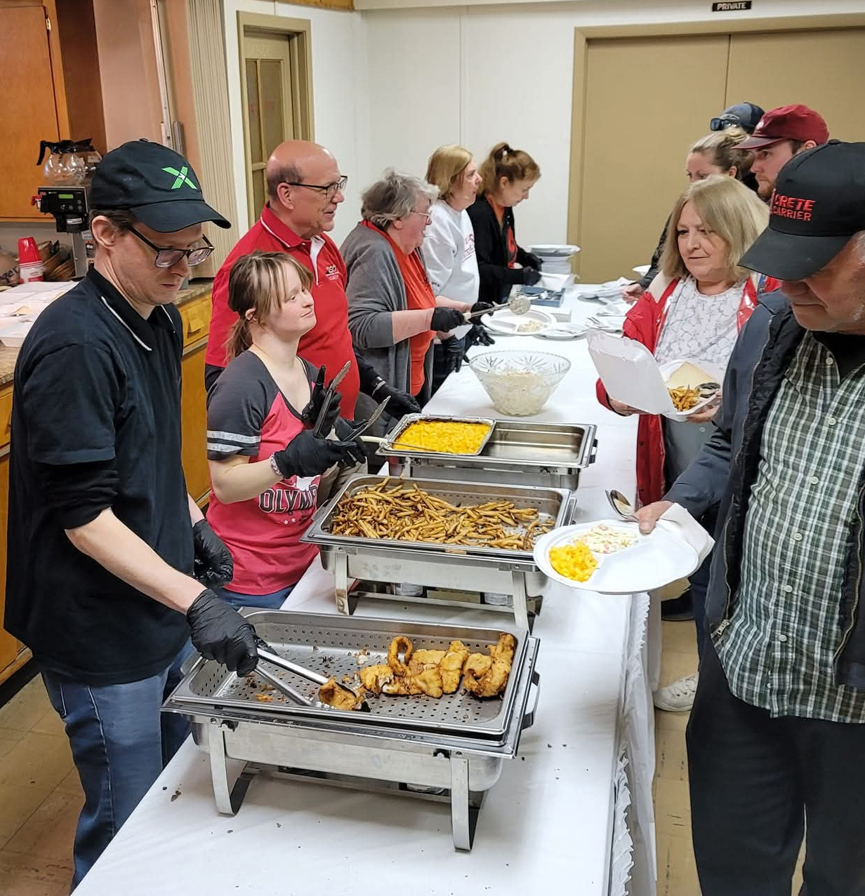
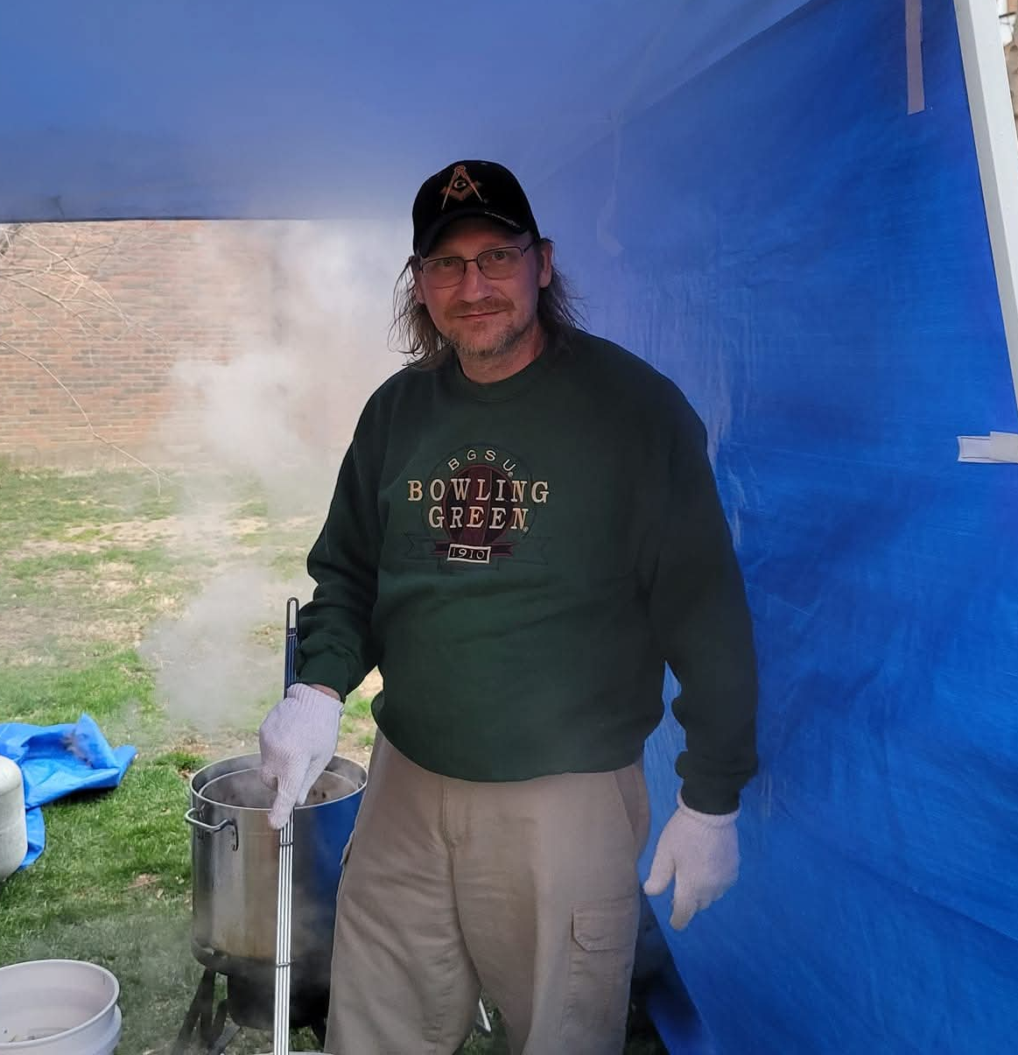

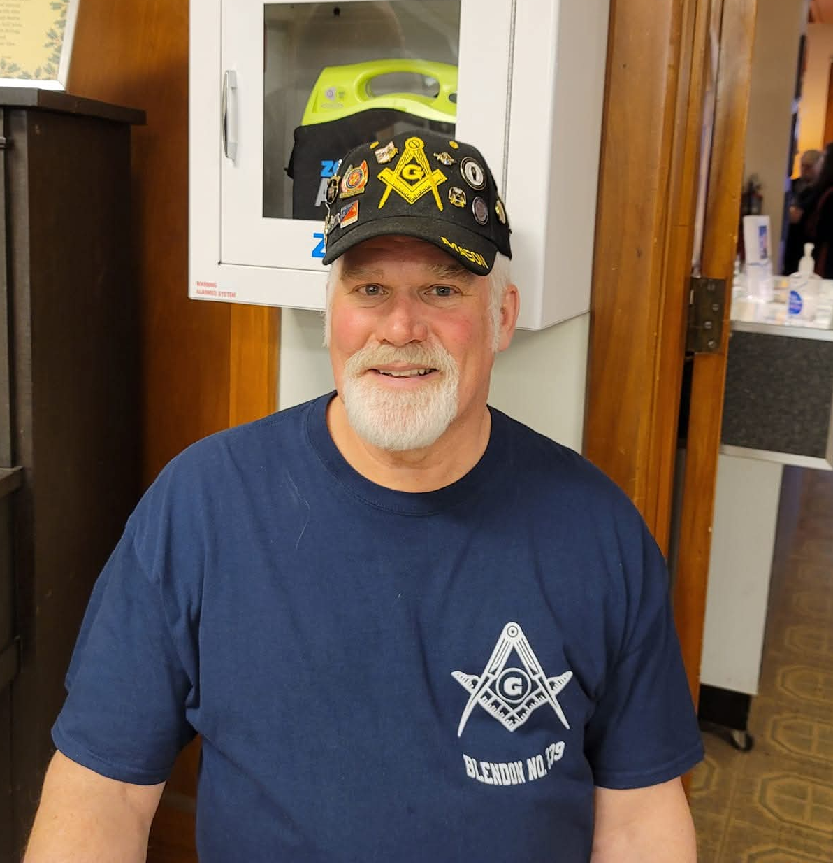
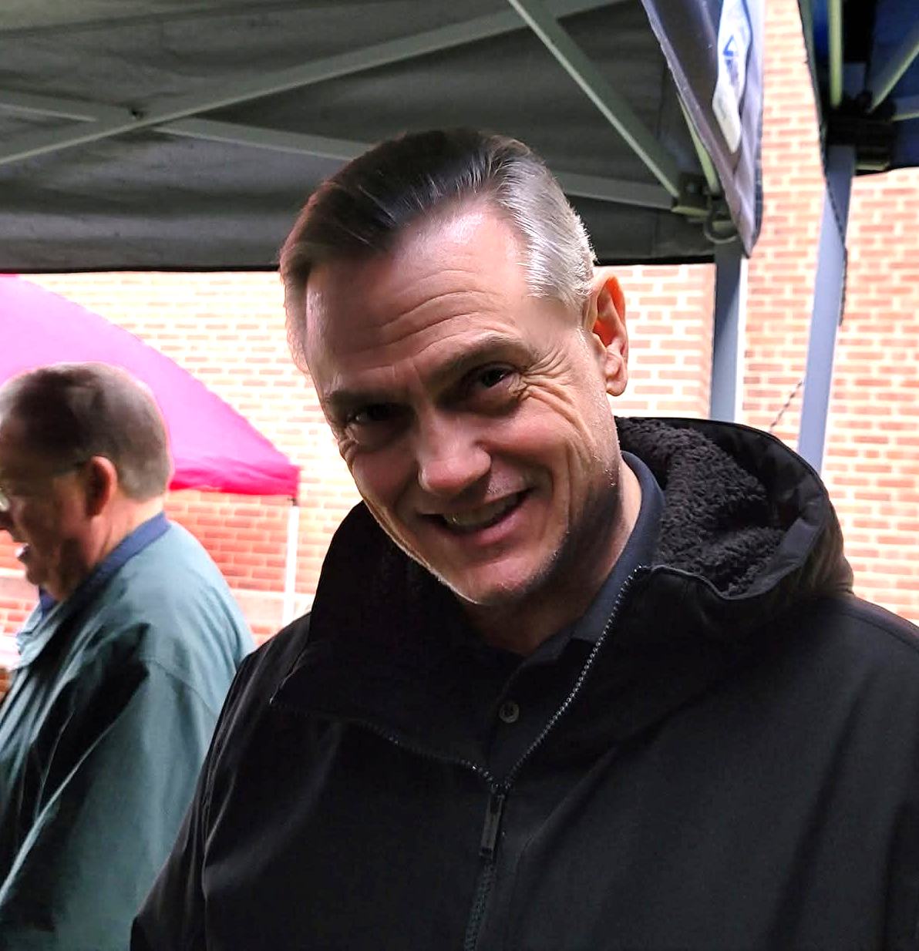
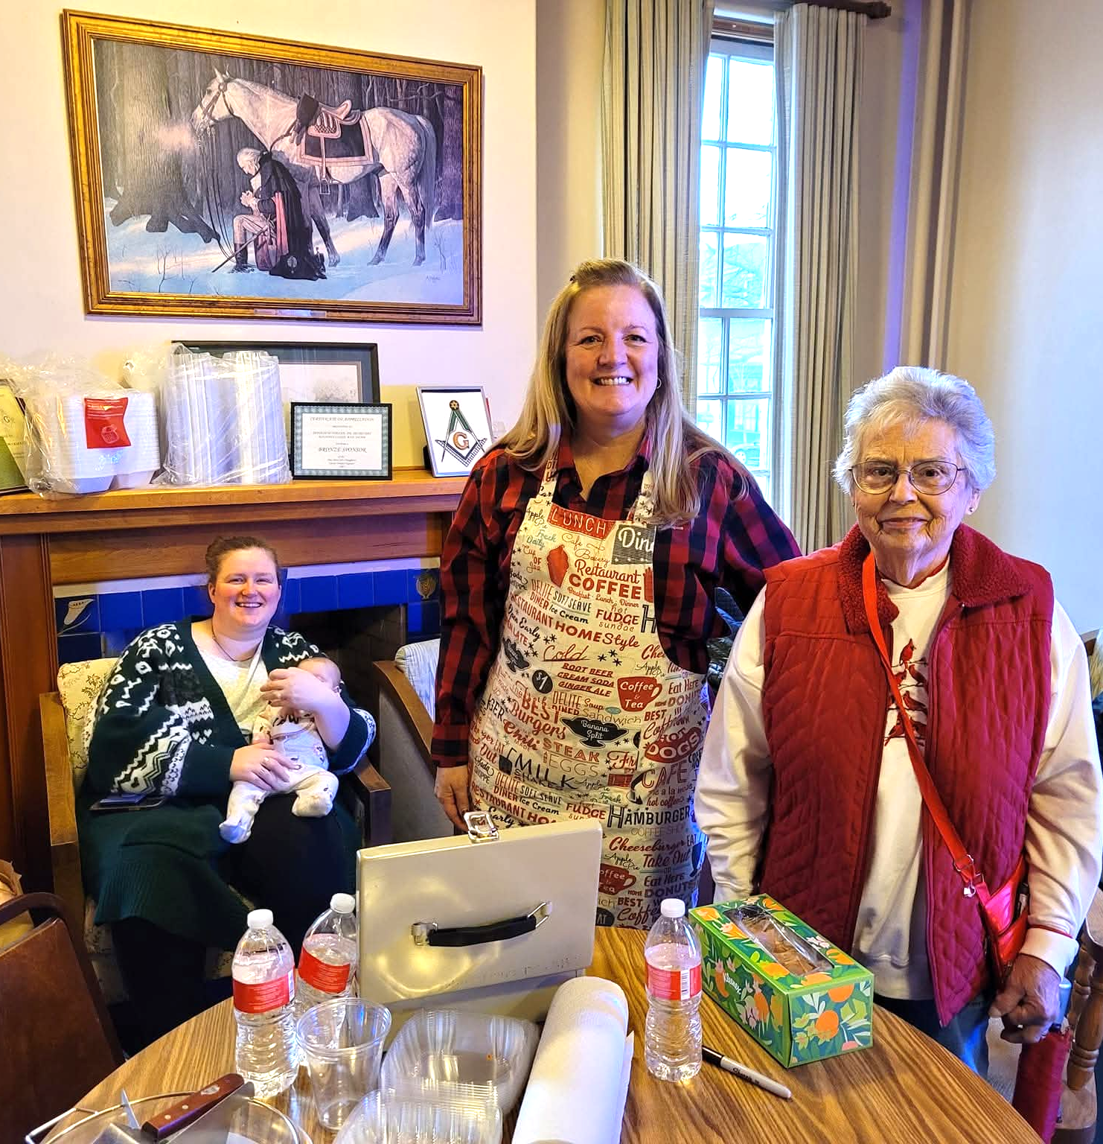

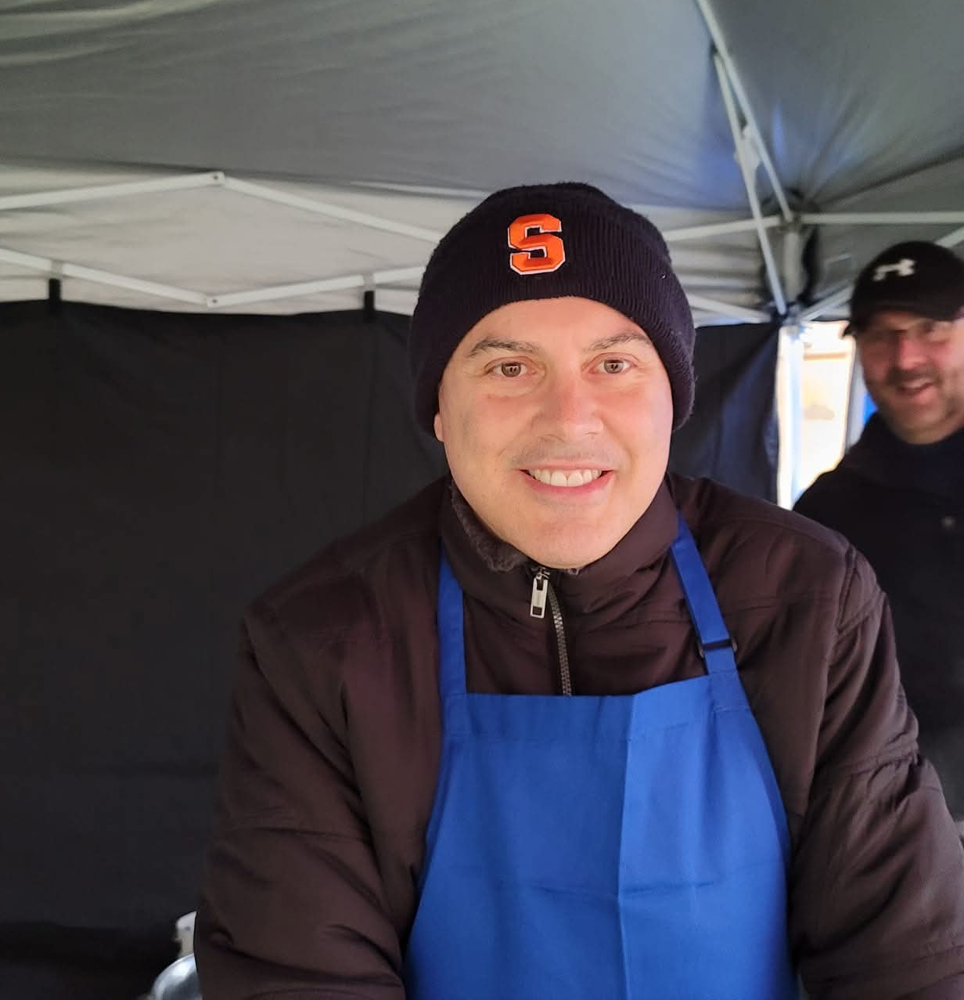
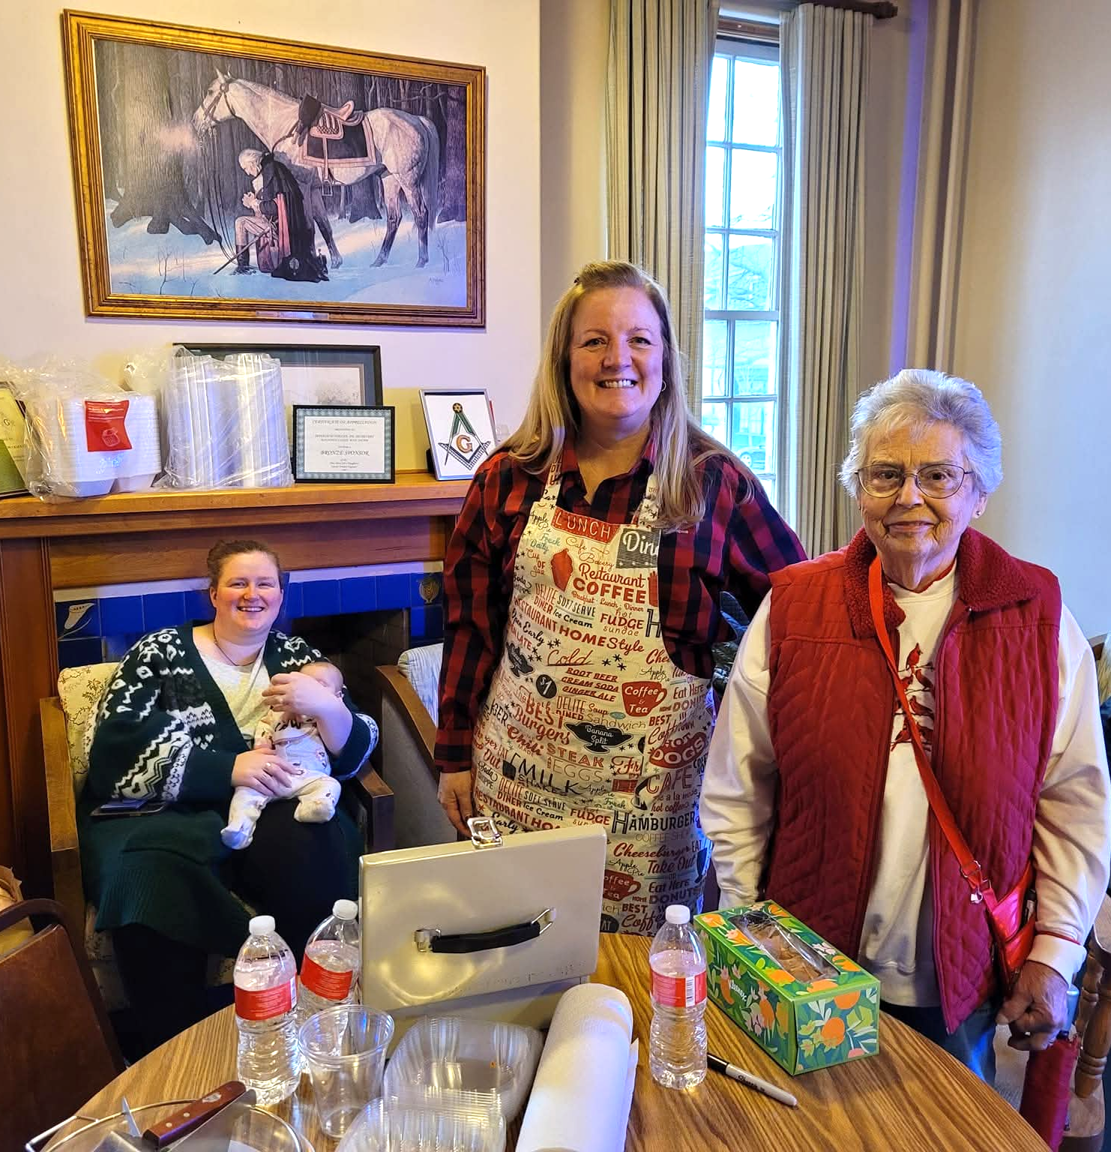

Get Involved in Marketing Next Year's Fish Fry
Know a Group We Should Reach?
Churches, clubs, youth groups, businesses. Help us grow our contact list
Be Social!
Like, share, and comment on our Facebook event. Invite friends online—it makes a big difference
Help Distribute Flyers
Take some to church, work, or your favorite coffee shop. Even 5 flyers in the right place help!
Connect Us
Have a media contact, politician, or community leader? Introduce us—we'll do the rest!
You don't need to be a marketer. Just being connected and willing to help is more than enough.

Slide 15


Available For All!
The marketing strategies presented tonight are available to download in the Masonic Education section of our website!
Download, discuss, engage and execute!

Slide 16
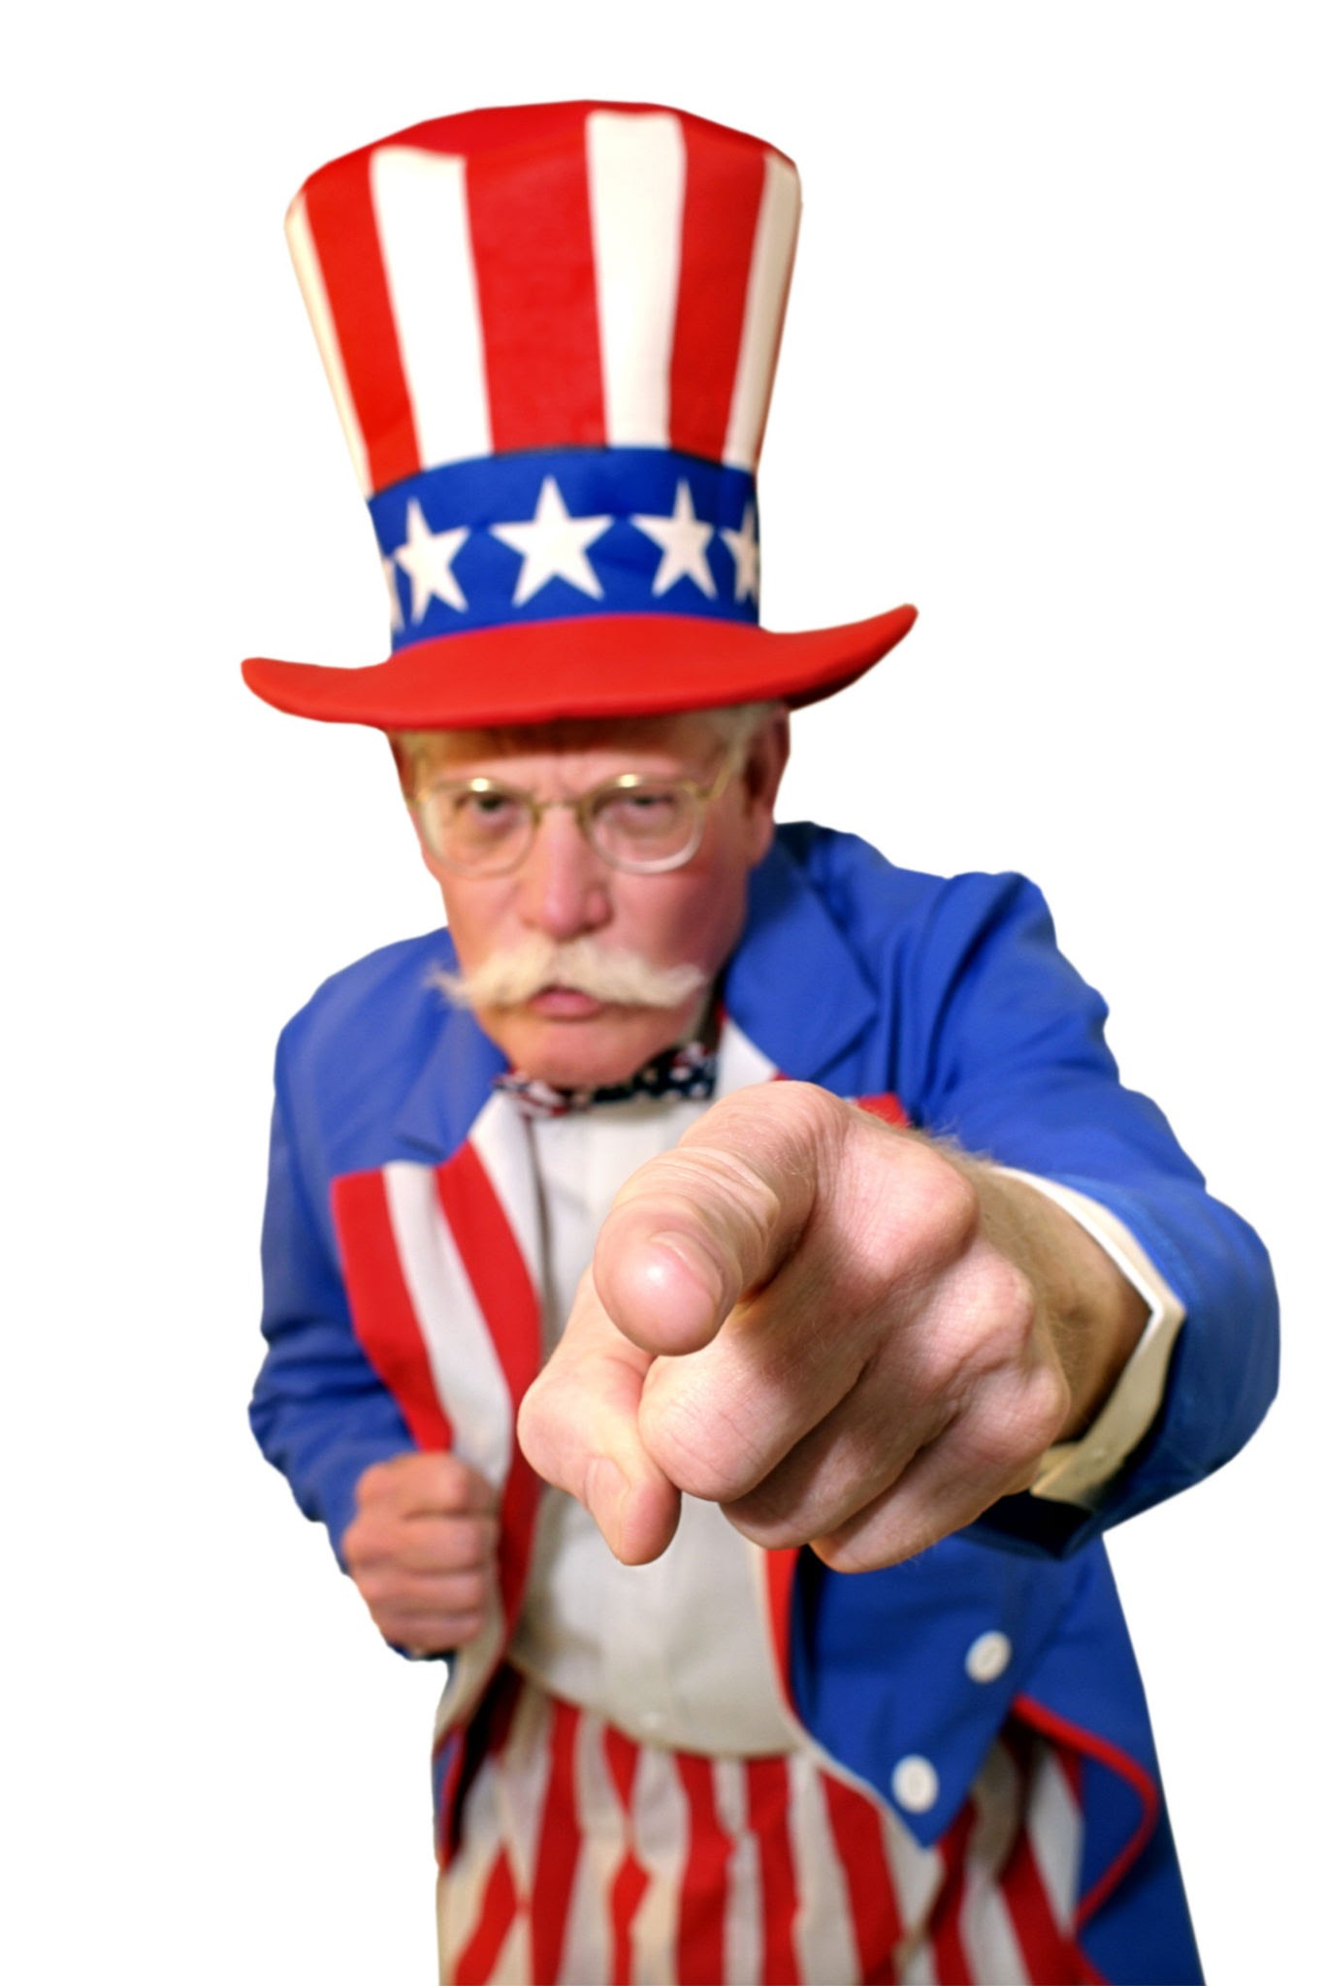

💬 Q&A: How Would You Market This Digitally?
Let’s workshop real ideas — focused on what actually works.
🎣 Scenario 1: The Fish Fry
If you were starting from scratch online...
What would you post first — and where?
How would you reach Westerville residents who’ve never been before?
What platforms would you prioritize — and why?
🎆 Scenario 2: Westerville 4th Friday Open House
Imagine we had a table right in front of our Lodge — how would you promote it digitally?
What kind of post grabs attention?
Who could we tag or partner with to boost visibility?
How would you create urgency or curiosity in a social post?

